Slide 1
Property Appraisals
Insurance Valuations and Current Market Conditions
May 2023

Slide 2

ICRMT and Kroll History
  Property appraisals started in 2018…..
  2018 – 2219 buildings and 68 members
  2019 – 3452 buildings and 84 members
  2020 – 3525 buildings and 100 members
  2021 – 2708 buildings and 102 members
  2022 – 4481 buildings and 91 members
  2023 – 1785 buildings and 98 members
  Over 18,000 buildings appraised!!!

Slide 3


Michael Domin
Michael Domin is a managing director of business development for the Fixed Asset Advisory Services (FAAS). He has more than 22 years of experience in the professional appraisal industry, and currently works to develop client solutions for public, private and nonprofit entities. As a consultant, Michael completed appraisals for various public entities including counties, cities, independent park districts, municipalities, universities, colleges, risk pools and school districts. He specialized in the appraisal of building construction and water and wastewater utilities. In addition, he valued traditional and modern churches, parishes, convents, and rectories. Michael has valued fixed assets and buildings for purposes of insurance, accounting, and property records. He has also completed infrastructure studies and performed valuations for compliance with GASB 34.
Michael joined American Appraisal (now Kroll) in 2000 and worked in various valuation consulting and management positions until 2008, when he joined the managing director staff.
Michael earned his Bachelor of Business Administration - Entrepreneurial Studies from Carthage College. He is a candidate member of the American Society of Appraisers within the Machinery & Technical Specialties discipline. Michael has completed numerous industry-related courses including REALL 110, GASB 34 Implementation Seminar, Architecture and Construction Trends for the 21st Century Church, Church Design and Construction Sound Advice, and Square Foot/Assembly Cost Estimating Workshop.
Managing Director
BA-Bachelor of Arts in Business Administration

Slide 4
Stay Ahead with KROLL
One Team, One Kroll.
Your preferred partner for all your complex global demands.
Data, technology and insights for risk, governance and growth
  Valuation
  Compliance and Regulation
  Corporate Finance and Restructuring
  Cyber Risk
  Environmental, Social and Governance
  Investigations and Disputes
  Business Services
With over 7,000 experts around the world, we create value and impact for
our clients and communities.

Slide 5
Dedicated Insurance Appraisal Practice
Dedicated Insurance Appraisal Practice
Our ITV Practice
Replacement cost valuation
is our core competency
100+ full-time Consultants and Project Managers on staff
No subcontractors
40,000 insurance appraisals per year
125+ years of continuous service to clients
Related Services
Kroll provides:
Financial reporting valuations
Tax advisory services
Fair market value services
Risk Consulting Advisory
  Cyber Risk
  Investigations
  Compliance
  Security Risk Management
We Are…
The world’s largest valuation advisor.
Independent
Global
Innovative

Slide 6
Property Insurance Appraisal Services
SERVICES
Building
Valuation Services
Diagnostic Review
Digital Reporting
Desk Based Valuation Services
Machinery & Equipment Valuation Services
Virtual Site Visits
Portfolio Review
Kroll provides comprehensive property insurance valuations
BENEFITS
Improved risk management and risk modeling
Determine adequacy of insurance coverage and retention/reinsurance analysis
Improved marketability to underwriters
Substantiation for proof of loss

Slide 7

Property Valuation, Why?
  Determine the adequacy of insurance coverage
    Complete property listing
    Accuracy of values
    No surprises at the time of loss
  Improved risk management
    Consistent approach to quantification of risk
  Improved marketability to underwriters
  Optimizes CAT modeling performance
  Basis for equitable allocation of premiums
  Basis for preparation of a “proof-of-loss”
  Partnership – Insured/Insurer

Slide 8
What Has Changed?
  A recent analysis of real property appraisals showed that 68% of buildings valued from 2020 to 2021 were underinsured by 25% or more and 19% were underinsured by 100%
  Cost increases in construction due to labor shortages, supply chain issues, material costs, etc. (COVID)
  Data, data and more data
    Catastrophe (CAT) risk models
    AIR and RMS
  Challenges with client-supplied information
  Loses – Example, 2021 billion-dollar losses
  Shift from soft to hard market
    Start – 2018 (“HIM” Storms - Harvey, Irma and Maria)
    End - ???

Slide 9
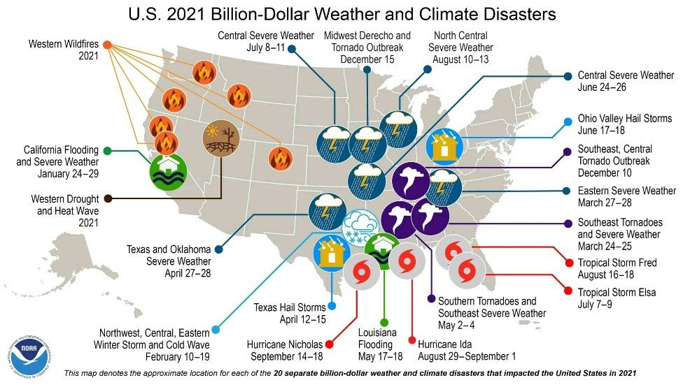
Ian – estimates between $53 billion to $74 billion
Katrina - $95+ billion – 2005 (adjusted for inflation – 2022)
Recovery to be slow and difficult due to inflation, high interest rates, and labor and materials costs

Slide 10
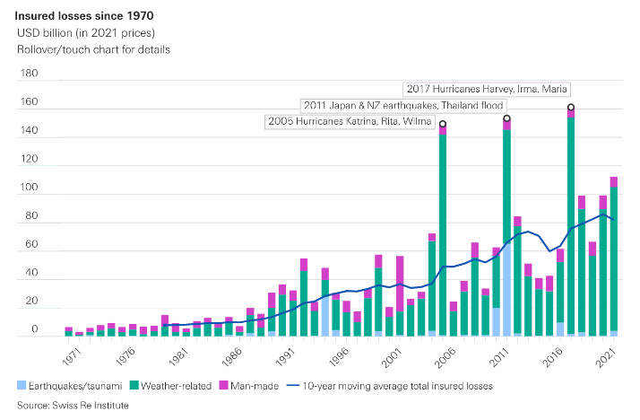

Slide 11
Current Cost Trends - Construction
  1986-2003 (1% to 3% per year)
  Significant construction inflation in 2004 (10.5%)
  Slowing but not back to normal in 2005 and 2006 (5.5% to 8.0%)
  A definite slowing in 2007 (2.8% to 4.7%)
  Commodities cause increases in 2008 (6.7 to 7.2%)
  Prices fall back with economy in 2009 (-7.0 to -0.3%)
  Inflation stabilizes in 2010 (-1.4% to +4.9%)
  Continued stabilization in 2011 (2.5% to 4.5%) & 2012 (1.5% to 2.8%) & 2013 (2.2% to 3.7%)
  Steady in 2014 (0.5% to 2.9%) 2015 (0.5 to 1.9%) 2016 (0.0 to 1.6%)
  Moderate increases in 2017 (1.2 to 4.0%)
  Larger increases in 2018 due to steel and labor (3.2 to 6.0%)
  Moderate increases in 2019 and 2020 (~1-3%/year)
  2021 annual numbers were significant compared to all other periods since the 1980s – (16% - 18.5%)
  2022 construction costs increased at a lower rate year over year
      FM Global +11.4%
      RS Means +8.7%
      Marshall & Swift +11.5%
      Last Two Years (25% - 30%)!
Sources cited:
  FM Global, Industrial Cost Trends, United States Industrial Building Average
  RS Means, 30 City Average Construction Cost Index
  Marshall & Swift, Quarterly Cost Index

Slide 12
US Equipment Manufacturing Cost Trends
2021 Cost Trends for US machinery and equipment:
Marshall & Swift, Industrial Average 19.6%
FM Global, Industrial Equipment Composite 6.72%
BLS, PPI Capital Equipment 12.16%
2022 Cost Trends for US Machinery and equipment
Marshall & Swift, Industrial Average 5.8%
FM Global, Industrial Equipment Composite 9.4%
BLS, PPI Capital Equipment 7.4%
  Currency fluctuations are creating new replacement cost realities for imported machinery and equipment.
Sources cited:
  Marshall Valuation Service, Marshall & Swift Quarterly Cost Index, Industrial Equipment Average of All
  FM Global, Industrial Cost Trends, Industrial Equipment Composite
  US Department of Labor, Bureau of Labor Statistics, Producer Price Index, Capital Equipment, Table WPUSOP3200

Slide 13
U.S. Building and Equipment Cost Trends Over Time
National Aggregate Cost Indices 2015 - 2023
Source cited:
  RS Means, Quarterly Construction Cost Trends, 30-City Average
  Marshall & Swift, Marshall Valuation Service, US Average
  FM Global, Industrial Cost Trends, United States Industrial Building Average
  US Department of Labor, Bureau of Labor Statistics, Producer Price Index, Capital Equipment, Table WPUSOP3200

Slide 14
Appraisal Comparison
High School Building – 347,331 Square feet ,
March 2021 Versus March 2023
Superstructure
  Site Prep $106,159
  Foundation $2,675,121
  Exterior` $28,977,120
  Roof $5,534,343
  Interior $10,916,124
  Mechanicals $29,175,417
  Built-ins $10,442,568
  Substructure $5,175,255
  Total RC $93,002,107
Superstructure
  Site Prep $137,424
  Foundation $3,462,999
  Exterior $37,511,477
  Roof $7,164,321
  Interior $14,131,147
  Mechanicals $37,768,177
  Built-ins $13,518,119
  Substructure $6,699,474
  Total RC $120,393,139
129%

Slide 15
Premise of Value
Definitions of Insurable Value
Replacement Cost Value
is the amount required to reproduce a property entirely at one time, as of a specific date, in like kind and quality and in accordance with current market prices for labor and materials
Insurable
Value
Actual Cash Value
is Replacement Cost Value less physical depreciation
Historic Reproduction Cost
is the amount required to reproduce a duplicate or replica of the entire property at one time, in like kind and materials
National Building Codes are included in the analyses, but insurance appraisers generally do not opine on any construction codes imposed by state/provincial or local municipalities, ordinances, or other legal restrictions. Also, "demand surge” costs are typically not included.
Cost of Demolition
in connection with reconstruction or the cost of debris removal can be included on a case-by-case basis.

Slide 16
Building Appraisal Methodology
Each major component of construction is segregated, identified and valued.
The appraiser validates the gross square footage of each building using physical perimeter measurements, high-def imagery and blueprints
ISO construction codes are captured; RMS construction and ATC occupancy codes are reported as needed
The following data elements are identified and reported:
Site Designation (Number/Name)
Building
Designation
Street Address
Year Built
ISO Classification
Square Footage
Story Height
Number of Floors
Perimeter
Occupancy
Roof Material
Exterior Wall Type
Heating
Cooling
Plumbing
Intrusion Alarm
Fire Protection
Elevators
Basement
Electric
Quality
Hillside Construction
Additional Features
Sprinkler System
GPS Coordinates
Roof Pitch

Slide 17
Personal Property
General Buildings– Modeling Approach
For general buildings, we will develop an opinion of the insurable value of personal property through use of a modeling approach, which relies on our proprietary database containing data from thousands of detailed equipment inventories we have performed. The model develops the insurable value of each building’s personal property on the basis of building occupancy and square footage and can be altered to account for above-or below-average density of personal property. A single insurable value will be reported for each building’s personal property.
Utility Assets
For utility buildings a high-level inventory of the personal property is created for each building. Stand-alone equipment asset items or major units are valued on an itemized basis. Stand-alone equipment asset items which have with a less material Cost of Reproduction New are valued in aggregate by property classification.
Equipment costing sources used include:
        Original Equipment Manufacturers and Distributors
        Industry Standard Estimating Sources
        Project Cost Analyses From Prior Valuations or Construction Projects
        Client Cost Estimates For Specially Designed and Built Assets
        Client or Outside Contractors’ Cost Breakdowns for Future Capital Investment Projects

Slide 18
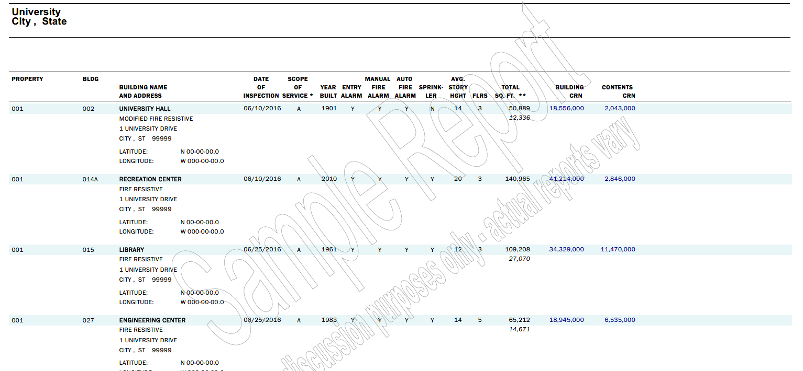
Sample Building Inspection and Appraisal Report
Sample SOV - Appraisal Report

Slide 19
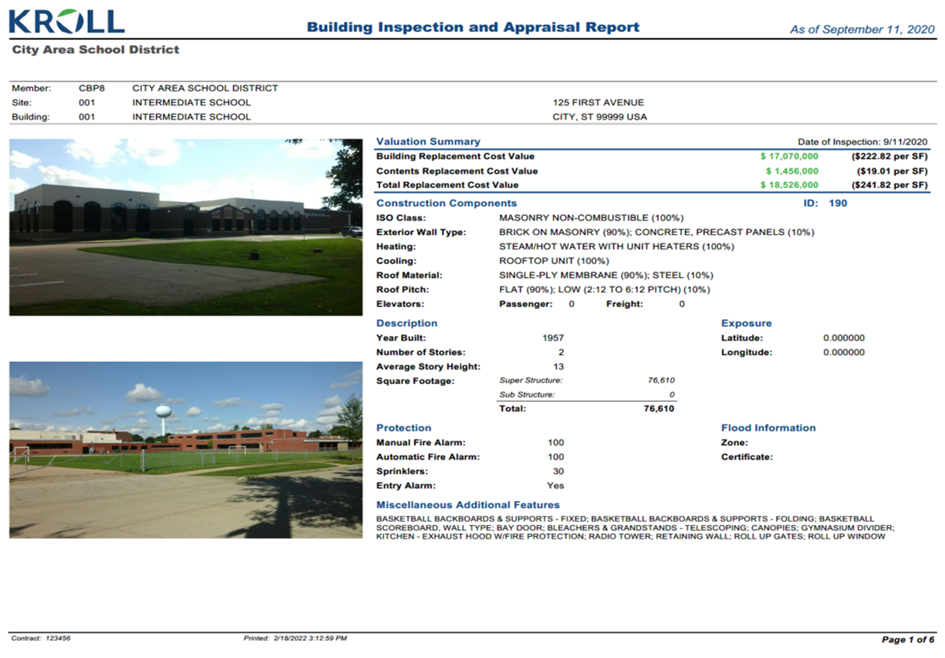
Sample Building Inspection and Appraisal Report
Sample Building Inspection and Appraisal Report

Slide 20
Appraisal Results
How to interpret your appraisal results
    Did values go up or down?
      If up…
          Additional square footage?
          Additional buildings?
          Both?
          Neither?
      If down…
          Reduction in square footage?
          Significant number of not found buildings?
          Both?
          Neither?

Slide 21
Food for thought!
        Comparing replacement costs
        Historic vs Modern construction
        Architecturally significant vs plain-Jane
        High quality materials vs low cost/quality
        Large vs Small building
        Replacement vs Reconstruction cost basis
Questions that you need to ask yourself?
  Are you confident that your statement of values accurately reports all of your insurable property?
  Have you kept pace with the change in assets within your facilities?
  Do you know where your properties’ reported insurable values come from?

