Slide 1
I’ve Been Sued!
Now What?
2023 ICRMT Member Conference
May 24-25, 2023

Slide 2

Summons
Your first notice of a lawsuit is typically the sheriff or a private process server showing up with a summons. The summons will have the date by which you are required to file an appearance and/or answer to the lawsuit. Time is of the essence, as a failure to answer by the required time can result in a default judgment. DO NOT DELAY!
Notes:
Delay can result in a default judgment, which the court may not vacate upon filing of appearance/answer at a later time.

Slide 3
Waiver
In federal court, the Plaintiff has the option of sending a Waiver of Service instead of a Summons.
FRCP 4(d) provides that a Defendant has a duty to avoid the unnecessary expense of service and execute the Waiver. If not, as a Plaintiff you may have to pay for the costs incurred for service.
If Defendant accepts service, then you are rewarded by a longer period of time for answering the complaint - 60 days.

Slide 4

Do Not Panic!
After receipt of the summons or a waiver of service, follow the notification practices put in place by your employer/public entity or insurer, ie. risk management, county or municipal clerk.
Make sure to provide a copy of the summons and complaint so that the exact nature of the action and/or claims made against you can be identified.
Not all of the claims may be covered by insurance and you need to know which are and which are not as early as possible.
Notes:
direct supervisor, risk management department, insurance broker, IPMG, or OKGC

Slide 5
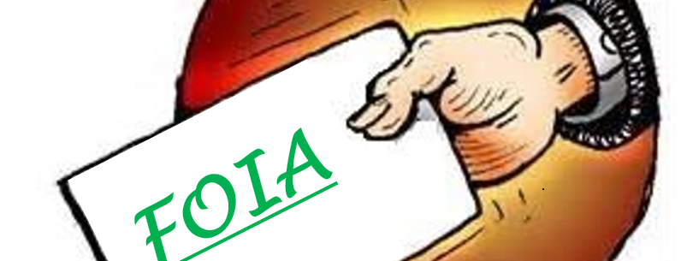
Other Indications…
A FOIA request, an attorney lien letter, pretrial publicity, or a simple phone call may also give you a sense that litigation may or is likely.
Get claims and your attorney involved as soon as possible – IFMK is routinely asked to do pre-suit investigations, such as party and witness interviews, document and/or audio/video review. This is best accomplished when memories are fresh and evidence is still available.

Slide 6

Open Door
The ICRMT has an “open door” policy – which allows for attorneys at IFMK to answer questions and provide guidance with any number of potential legal issues, often even before a claim has been opened or you have been sued.

Slide 7
Representation
For claims or actions which are covered by insurance, you will be provided an attorney. The sooner that you have provided notification of the lawsuit, the sooner you will be contacted by your attorney.
Make sure to ask if you are required to make a formal or written request to be represented in the pending lawsuit.

Slide 8
Reservation of Rights
Depending on the nature of the claims or damages that are sought in the lawsuit, you may receive a reservation of rights (“ROR”) letter. Review same carefully as it will set forth what claims and damages are and are not covered.
For example, if you are being sued for punitive damages, those damages are NOT covered by insurance. The ROR letter will advise that you can retain your own attorney AT YOUR OWN COST to defend you with respect to these damages.

Slide 9
First things first….
Prior to talking with the attorney:
  Review the complaint in detail - True vs. False;
  Collect and review any and all documents, reports, videos, pictures, correspondence, emails, or other tangible evidence, that you or the public entity may possess;
  Determine if there are any witnesses.
Notes:
Lack of knowledge would also be important to know
Keep in mind that other departments or people (IT guys) may also have information relative to the claim made (ie)slip and fall cases may have a police, fire, or EMS report that contains useful information about scene conditions, witnesses, or statements made by the Plaintiff at the time of the fall.

Slide 10
Initial Meeting
Discuss the allegations;
Provide all of the records, documents, and evidence you have accumulated to date, and Identify what additional documents you need to locate and preserve.
Determine potential witnesses;
Determine what, if any, further investigation needs to be done; and,
Timeline of how the lawsuit will progress.

Slide 11

Fear of Spoliation
Once you have been served with a lawsuit, or received a letter notifying you of a potential claim and attorney representation, you need to preserve every iota of evidence relative to that potential claim.
To that end, loop in the technical gurus (IT) to make sure that all electronic information is also preserved.

Slide 12
Litigation Hold
Your attorney will send you a letter early on detailing yours and the public entity’s legal obligation to preserve all information relative to all of the claims made by Plaintiff, including both paper records/documents and electronically stored information (“ESI”) on computer systems, on removable or portable electronic storage media, and on your personal home or portable computer.

Slide 13
Scope of Documents
Non-electronic/paper documents and evidence in whatever form, including personal or desk files, calendars, notes, correspondence, internal memorandum, reports and drafts (partial or complete), work logs, rosters, policies and procedures, manuals, or other things relevant to the case.
CAST A WIDE NET TO CATCH EVERY ITEM THAT MAY BE HELPFUL IN DEFENDING THE CLAIM,

Slide 14
What Is ESI
Digital communications such as e-mails, voice mail, texts and instant messaging (this includes “deleted” files and file fragments);
E-mail server stores;
Word processed documents, including all drafts and revisions;
Spreadsheets and tables such as Excel documents, including all drafts and revisions;
Video and Audio recordings;
Databases;
Contact and relationship management data such as Outlook;
Calendar and diary application data;
All data created using PDAs, smart phones, cell phones, including text messages and instant messages;
Online access data such as temporary internet files, history and cookies;
Network access and server activity logs;
Backup and archival files;
Metadata; and
Images contained in hard drives retained by the MUA but no longer in use.
Must be retained and preserved in its originally-created, or “native” format, until resolution of the lawsuit.

Slide 15
Be Mindful of Data Practices
Data destruction and back-up tape recycling policies must be discontinued until further notice.
The obligation to preserve is a “continuing” obligation and applies to information created after, as well as before, suit was filed.
You should identify and modify or suspend features of computers or devices that, in routine operation, cause the loss of potentially relevant ESI.
You should remove from service and sequester the systems, media and devices housing potentially relevant ESI. If it is not practical to sequester systems, media and devices, then a forensically sound imaging of the systems, media and devices should be performed.

Slide 16

Communications
Only communications with your attorney are privileged. Discussions outside of that are generally discoverable in terms of the identity of the person to whom you spoke, wrote, emailed, or texted and the contents of that communication.
DO NOT POST, CHAT or otherwise discuss anything about the lawsuit on any social media sites. These public comments will be found and you will be asked to produce any such posts or discussions during discovery.
DO NOT REACH OUT TO THE PLAINTIFF OR HIS/HER ATTORNEY.

Slide 17

Conflicts
In cases with multiple individual Defendants, another issue your attorney should discuss with you early on is whether there is an actual OR potential conflict of interest between you and the other Defendants, including your employer.

Slide 18

Venue
Occasionally, Plaintiff’s choice of venue may not be our first choice for where the litigation should proceed – such as state vs. federal court, or one county or another.

Slide 19

Discovery
After the parties are at issue, the discovery process begins.
Interrogatories
Document Requests
Requests to Admit
Depositions

Slide 20
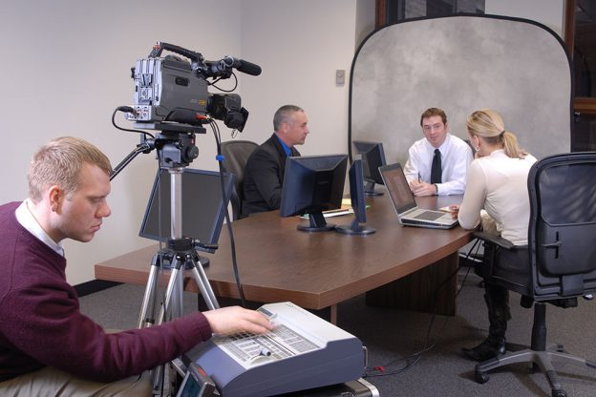
Depositions
After the written portion of discovery is completed, depositions begin.
Parties
Witnesses
Experts
Anyone who is a party can attend depositions.

Slide 21

Next Move….
Typically at this stage, the parties are in the best position to evaluate the strengths and weaknesses of their respective sides and to determine whether or not it makes sense to resolve the suit prior to trial, or whether a dispositive motion may be appropriate.

Slide 22

Indemnification
Illinois statute provides that the public entity pay any tort judgment or settlement for compensatory damages for acts occurring within the scope of your employment. 745 ILCS 10/9-102.

Slide 23
Don’t Take This Personally!
The decision about whether or not to settle a lawsuit is typically a cost-benefit analysis and whether it makes financial sense to compromise the litigation at any point in time (or earlier).
There are several factors that go into this decision, including:
The likelihood of a favorable defense verdict;
The nature and extent of the Plaintiff’s injuries;
The venue;
Expert and further defense costs; and,
Whether the individual Defendant may be subject to punitive damages.

Slide 24
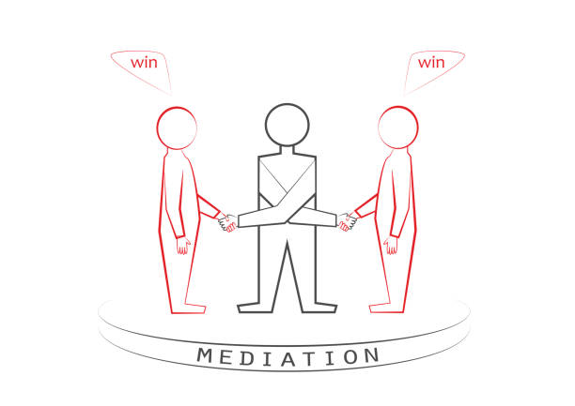
Mediation and Arbitration
Process by which the parties meet with an independent third party to attempt resolution.
Can be done privately or with the court.

Slide 25

Trial
Sometimes, cases cannot be resolved and go to trial.
Trials can either be by jury or by a judge.
In federal court, we also have a choice between the district judge or a magistrate.

Slide 26
In Conclusion…
Litigation can be stressful, but OKGC is here to help lessen the stress and guide you through and help navigate this complicated process.
Do Not Delay – acting quickly when you receive notice of a lawsuit can make all of the difference.
Ask Questions and understand what your role is in the process and what you will need to do to assist with your defense.
Save all potential evidence, including ESI, that is relevant to the claims. Do Not Delete anything!
Be mindful and avoid any discussion on social media about the lawsuit, the parties, or the attorneys involved.
Finally, Do Not Panic – OKGC is here to help!

