Slide 1

NEW EMPLOYMENT LAWS EVERY EMPLOYER NEEDS TO KNOW
Presented by: Karin Anderson
IFMK Law, Ltd.
kanderson@ifmklaw.com
847/291-0200
May 24, 2023

Slide 2
Overview of New Employment Laws
New Legislation
Paid Leave for All Workers (PLAW) Act
IL Equal Pay Act Amendment(s)
Wage Payment and Collection Act Amendment
One Day Rest in Seven Act (ODRISA)
Family Bereavement Leave (FBL)
PUMP Act
Minimum Wage Law
IL Human Rights Act Amendments
Prohibiting Sexual Orientation and Gender Identity Discrimination
Artificial Intelligence and Title VII
VESSA Amendments
On the Horizon
  FLSA Salary Thresholds
  DOL Test for Independent Contractor versus Employee
  Right to Privacy in the Workplace Act Amendment
  IL Family Insurance Leave Act (HB 1102): (re) introduced after passing PLAW Act

Slide 3

Paid Leave for All Workers
THE PLAW ACT
Effective January 1, 2024
“Up to a minimum” of 40 hours of paid leave in 12-month period;
OR
Earn 1 hour of paid leave for every 40 hours worked, “up to a minimum" of 40 hours
820 ILCS 192/1 et seq.

Slide 4
PLAW Leave Essentials
“[T]he provisions of this Act shall be liberally construed in favor of providing workers with the greatest amount of paid time off from work and employment security.”
PLAW leave can be used for any purpose
Employees are NOT required to provide a reason for the leave
Employees CANNOT be required to find a replacement before taking leave
Employees may NOT be required to provide documentation in support of leave
Employees MAY use PLAW leave before taking other leave offered by employer or State
Minimum increment of PLAW leave cannot exceed 2 hours per day
Unused PLAW leave reinstated if separated employee rehired within 12 months

Slide 5

Notice of PLAW Leave
Employer can only require notice if it creates and distributes a written policy with notice procedures
7-day notice if foreseeable
As soon as practicable if unforeseeable

Slide 6
PLAW Leave Accrual
Upfront = Use It or Lose It
IF full 40 hours of paid leave provided on 1st day of employment,
THEN employer can require it be used by end of 1st year of employment
--------------------
IF full 40 hours of paid leave provided on 1st day of 12-month period,
THEN employer can require it be used by end of 12-month period
Accrual = Roll over
IF leave accrues over time,
THEN employee can carry over unused leave into next 12-month period
--------------------
Accrual begins 1st day of employment or effective date of Act, whichever is later
Employees may use accrued leave 90 days thereafter

Slide 7


To Pay or Not To Pay
IF PLAW leave is combined with other leave such as PTO, vacation, personal, etc.,
THEN unused PLAW leave MUST be paid out
IF PLAW leave is segregated from other leave banks,
THEN unused PLAW leave need NOT be paid out

Slide 8
Employer Obligations and Penalties
OBLIGATIONS
Maintain health plan coverage for employees on leave
Preserve records of leave accrual and usage for 3 years
Post notice summarizing requirements of the Act in conspicuous place
Post notice summarizing requirements of the Act in policy manual
PENALTIES
Violation of posting requirement $500 penalty for 1st offense; $1000 for subsequent offenses
Damages for underpayment, compensatory damages, penalties between $500 and $1000, attorney’s fees and costs
Separate civil penalty of $2,500 against employers paid into special enforcement fund

Slide 9
PLAW Leave Miscellaneous
PLAW Act does not affect validity of CBA in effect on January 1, 2024
PLAW Act can be waived in CBA ONLY if waiver is explicit and in clear and unambiguous terms
Employee CANNOT waive his/her rights under PLAW Act
Act N/A to employer covered by municipal or county ordinance in effect on effective date of PLAW Act that requires paid leave to employees
  Cook County
  City of Chicago
Local ordinance enacted or amended AFTER effective date of PLAW Act must comply with Act or provide benefits greater than or equal to those under Act

Slide 10
Unanswered Questions???
Earn 1 hour of paid leave for every 40 hours worked, “up to a minimum” of 40 hours
Employees MAY use PLAW leave before taking other leave offered by employer or State
Unused PLAW leave must be reinstated if separated employee rehired within 12 months
Accrued leave can be used after 90 days OR carried over into next 12-month period
Employers with policy of at least 40 hours of paid leave “at the employee’s discretion…for any reason” are not required to modify their policy
Effective January 1, 2024
What if PT employee does not earn a “minimum” of 40 hours of paid leave?
Does this permit employees to use PLAW leave before taking FMLA, VESSA, FBL, or other paid or unpaid leave?
How does this affect employer’s hiring of seasonal employees who return each year?
If carried over, does new leave accrue for seasonal employees?
Must the leave be available at start of 12-month period and/or subject to same terms as PLAW leave? CBA?
When will DOL issue regulations?

Slide 11

Illinois Equal Pay Act
Effective 2019
Prohibits unequal wages between:
  men and women
  African-American and non African-American
820 ILCS 112/1 et seq.

Slide 12

“Pay Scale” Amendment
May 17, 2023: Passed both Houses
Effective January 1, 2025
"Pay scale and benefits":
The wage or salary, or the wage or salary range, and a general description of the benefits and other compensation, including:
  bonuses, stock options, or other incentives the employer reasonably expects in good faith to offer for the position, set by reference to any applicable pay scale,
  the previously determined range for the position,
  the actual range of others currently holding equivalent positions, or
  the budgeted amount for the position, as applicable.

Slide 13
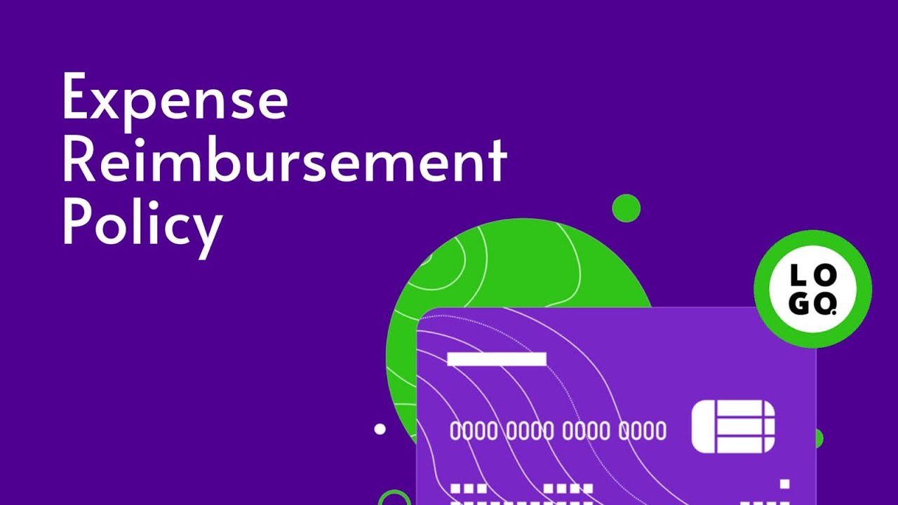
Wage Payment and Collection Act
Effective January 1, 2019
IWPCA was amended to require employers to reimburse employees for all “necessary expenditures or losses” incurred by the employee within the employee’s scope of employment and that that inure to the “primary benefit” of the employer.

Slide 14

Reimbursement of Employee Expenses
Effective March 31, 2023
Primary Benefit to Employer
Whether the employee has any expectation of reimbursement;
Whether the expense is required or necessary to perform the employee’s job duties;
Whether the employer is receiving a value that it would otherwise need to pay for;
How long the employer is receiving the benefit; and
Whether the expense is required of the job.

Slide 15

One Day Rest in Seven Act
Effective January 1, 2023
Workweek redefined as “consecutive 7-day period” (rather than calendar week)
Meal period of 20+ min for 7.5 hour shift with break no later than 5th hour
Additional 20+ min meal period for each additional 4.5 hours workedl penalties.
Penalties
Notice required
820 ILCS 140/1 et seq.

Slide 16

Illinois Family Bereavement Leave Law
Effective January 1, 2023
FBL is unpaid leave for eligible employees
  Worked 1250 hours in preceding 12-month period
Amended the Child Bereavement Leave Law to include:
  death of a covered family member
  reasons related to pregnancy, fertility, adoption and surrogacy
Maximum of 10 working days of unpaid leave
  Exception for deaths of multiple covered family members
820 ILCS 154/1 et seq.

Slide 17
Expanded Coverage under FBL
Covered family member Includes:
Parent (step, in-law, step parent-in-law) (FMLA excludes in-laws)
Spouse
Domestic partner
Child (step, adopted, foster, ward, over 18 incapable of self-care, in-law)
Sibling (half-sibling, step, adopted)
Grandparent; grandchild; legal guardian
Reasons related to pregnancy, fertility, adoption and surrogacy include:
Miscarriage
Unsuccessful intrauterine insemination or assisted reproductive technology procedure
Failed adoption
Failed surrogacy agreement
Diagnosis negatively impacting pregnancy or fertility
Stillbirth

Slide 18

Providing Urgent Maternal Protections for Nursing Mothers Act
Effective December 29, 2022
April 28, 2023-full remedies
The “PUMP Act” (FLSA)
Breaks of 20 min are hours worked
Cannot deny break to employee
Notice of FLSA rights required

Slide 19
Pump at Work Protections
ILLINOIS LAW
Effective August 21, 2018
“Nursing Mothers in the Workplace Act”
Reasonable break time each time employee has the need to express milk
  Unless undue hardship under HRA
Cannot deduct pay for nursing/pumping breaks
Up to one year after birth of a child
Reasonable effort to provide private room close to work area
FEDERAL LAW
Effective December 29, 2022
“PUMP Act”
Must provide reasonable break time each time employee has the need to express milk
Breaks 20-min or less are “Hours Worked Under FLSA”
Paid, if other breaks are paid or unless completely relieved of duties
Up to one year after birth of a child
Must be provided a private space, shielded from view and free from intrusion from coworkers and the public
Penalties include wages, equal amount as liquidated damages, compensatory damages, punitive damages
Employer with fewer than 50 employees are not subject to FLSA break time and space requirements IF undue hardship

Slide 20

Illinois Minimum Wage Law
Effective January 1, 2023
Minimum wage in Illinois is $13/hour
On January 1, 2024, minimum wage will be $14/hour
On January 1, 2025, minimum wage will be $15/hour
Note: As of January 1, 2023, minimum wage in Cook County is $13.35/hour.
Note: As of July 1, 2022, minimum wage in Chicago is $14.50 (4-20 employees) and $15.40/hour (21 or more employees)
820 ILCS 105/1 et seq.

Slide 21

Jett Hawkins Law
Effective January 1, 2022
Illinois Public Act 102-0360
Amended Illinois School Code, 105 ILCS 5/2 et seq.
Jett Hawkins was a 4-year old boy in Chicago who was sent home from school for wearing his hair in braids and a ponytail in violation of the school’s dress code.

Slide 22

CROWN Act
Effective January 1, 2023
Extends protections of Jett Hawkins law beyond schools to areas of employment, housing, financial transactions and public accommodations
Protects hairstyles historically associated with race, ethnicity, or hair texture such as braids, locs and twists
Amended Illinois Human Rights Act, 775 ILCS 5/1 et seq.

Slide 23

Federal CROWN Act
U.S. House of Representatives passed a national version of the CROWN Act in March 2022
U.S. Senate blocked the bill in December 2022

Slide 24

Disability Discrimination
Effective January 1, 2022
Public Act 102-0419 amended the Illinois Human Rights Act, 775 ILCS 5/1-103(I)(2)
Prohibition of disability discrimination to include the individual’s association with a person with a disability.

Slide 25
Work Authorization Status Discrimination
Effective August 2, 2021
Added work authorization status to protected classifications under the IHRA
Cannot discriminate in any employment action (hiring, discipline, promotion, termination, etc.) on basis of work authorization status
Public Act 102-0233 amended Illinois Human Rights Act,

Slide 26

Criminal Background Checks
Effective March 23, 2021
Senate Bill 1480 amended the IL Human Rights Act
The “Amendment” was intended to provide individuals who have been involved with the criminal justice system a fair chance to obtain employment by restricting the use of criminal conviction records.
Illinois Human Rights Act, 775 ILCS 5/1 et seq.

Slide 27

Use of Conviction Records
Employers who perform criminal background checks are required to perform an individualized assessment before basing an adverse employment decision on an individual’s “conviction record.”
NOTE: “Ban-the-Box” legislation effective January 1, 2015 applied to private entities with 15 or more employees

Slide 28
Individualized Assessment
An employer is prohibited from basing an adverse employment decision on an individual’s conviction record unless:
“Substantial Relationship”
  position offers the opportunity for the same or similar offense to occur or circumstances that led to past conduct will recur in the position
  OR
“Unreasonable Risk”
  individual poses an unreasonable risk to property or safety of the employer’s workforce, customers or members of the public

Slide 29

Interactive Assessment
IF a substantial relationship or unreasonable risk exists, the employer MUST engage in an interactive assessment and MUST consider ALL of the mitigating factors
Mitigating factors are found in the EEOC’s 2012 Enforcement Guidance
Now they are required by law

Slide 30


Mitigating Factors to Consider
Length of time since conviction
Age at time of conviction

Slide 31



More Mitigating Factors
The number and severity of the convictions

Slide 32
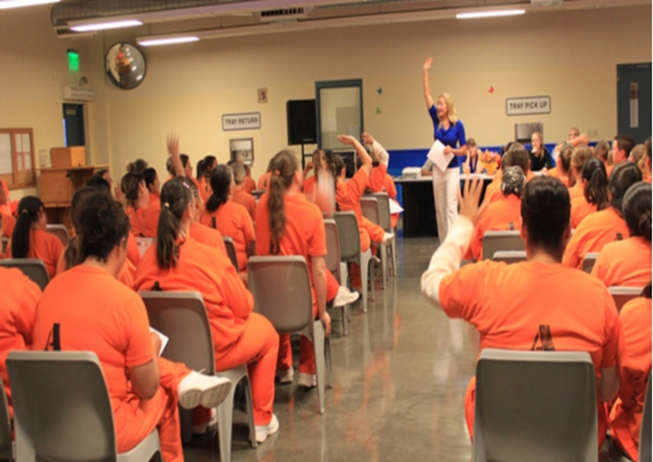

Final Mitigating Factors
Facts and circumstances
  Evidence of rehabilitation

Slide 33
Written Notice of Decision
PRELIMINARY DECISION
Notice must contain ALL of the following:
  The disqualifying conviction
  The employer’s reasoning for disqualification
  A copy of the conviction report
  Explanation of employee’s right to 5+ business days to respond with:
    Evidence challenging accuracy of record
                OR
    Evidence of mitigation, e.g., rehabilitation
FINAL DECISION
Notice must contain ALL of the following:
  The disqualifying conviction
  The employer’s reasoning for disqualification
  Procedure for challenging decision or requesting reconsideration
  Employee’s rights to file a charge with the IDHR
  NOTE: Notice requirements in bold are in addition to requirements under FCRA

Slide 34
Sexual Orientation and Gender Identity Discrimination
Title VII: discrimination against homosexual or transgender employees is barred by the prohibition against sex discrimination
  Bostock v. Clayton County, Georgia, ___ U.S. ___ , 140 S. Ct. 1731 (2020)
Title IX: discrimination against transgender, nonbinary, and gender nonconforming students is considered a form of sex discrimination in violation of Title IX
  Whitaker ex rel. Whitaker v. Kenosha Unified Sch. Dist. No. 1 Bd. Of Educ., 858 F.3d 1034, 1046-51 (7th Cir. 2017)
Illinois Human Rights Act: discrimination against employee based on gender identity is a violation of the Human Rights Act
  Hobby Lobby Stores, Inc. v. Sommerville, No. 2-19-032, 2021 IL App (2d) 190362, ¶ 26
  the Act defines “sex” as “the status of being male or female.” The phrasing of this definition is broad: it does not draw distinctions based on genitalia, the sex marker used on a birth certificate, or genetic information. Moreover, it uses the word “status.” At law, a “status” is a state of being that may be subject to change.

Slide 35
Adverse Impact of Software, Algorithms, and Artificial Intelligence
May 18, 2023
EEOC released Technical Assistance document on Artificial Intelligence and Title VII
“As employers increasingly turn to AI and other automated systems, they must ensure that the use of these technologies aligns with the civil rights laws and our national values of fairness, justice and equality.”
Title VII prohibits employers from using neutral tests or selection procedures that have the effect of disproportionately excluding persons based on race, color, religion, sex, or national origin, if the tests or selection procedures are not “job related for the position in question and consistent with business necessity.”
This is called “disparate impact” or “adverse impact” discrimination.

Slide 36
Selection Rate and 4/5 Rule
Selection Rate
Example: 80 White individuals and 40 Black individuals take a personality test that is scored using an algorithm as part of a job application. 48 of the White applicants and 12 of the Black applicants advance to the next round of the selection process.
The selection rate for Whites is 48/80 (equivalent to 60%), and the selection rate for Blacks is 12/40 (equivalent to 30%).
Four-fifths Rule
The four-fifths rule is a general rule of thumb for determining whether the selection rate for one group is “substantially” different (< 80%) than the selection rate of another group.
May be used to draw an initial inference that the selection rates for two groups may be substantially different, and to prompt employers to acquire additional information
Q: Is the selection rate substantially different?

Slide 37

Artificial Intelligence Video Interview Act
Effective January 1, 2022
Public Act 102-47 amended 820 ILCS 42/20(a)
Employers who rely on AI to screen video interviews to select candidates for in-person interviews must collect the following demographic data:
  the race and ethnicity of applicants who are offered an in-person interview
  the race and ethnicity of applicants who are not offered an in-person interview
  the race and ethnicity of applicants who are hired

Slide 38
Victims’ Economic Security and Safety Act
Effective January 1, 2022
Expanded eligibility for leave to include “any other crime of violence”
Expanded definition of “family or household member”
Employee may choose which certification document to provide
Protects individuals “perceived to be” a victim
Added a confidentiality provision
820 ILCS 180/1 et seq.

Slide 39

VESSA Leave
Length of leave depends on size of employer
12 weeks: 50 or more employees
8 weeks: 15-49 employees
4 weeks: 1-14 employees
Restoration to same or equivalent position

Slide 40

On the Horizon…
FLSA Salary Thresholds
1990-2020
  $455/week
  $23,660/year
Obama Proposal
  $913/week
  $47,476/year
Trump/Current
  $684/week
  $35,568/year
Biden Proposal
  $900-$1000/week
  $46,800-$52,000/year

Slide 41
Independent Contractor or Employee
Current Rule: Core Factors
Five-factor Test
Nature and degree of control retained by employer
Opportunity for profit or loss
Amount of skill required for the work
Degree of permanence of the working relationship
Whether the work is an integrated unit of production
Proposed Rule: Economic Reality Test
Six-factor Test
Opportunity for profit or loss depending on managerial skill
Investments by the worker and the employer
Degree of permanence of the work relationship (including exclusivity)
Nature and degree of control
Extent to which the work performed is an integral part of the employer's business
Skill and initiative

Slide 42

Right to Privacy in the Workplace Act
May 8, 2023: Passed Both Houses
Amends Use of Employment Eligibility Verification Systems
Restricts the employer’s ability to take adverse action based on notice from Social Security Administration of discrepancy between name and SSN of employee.
Must grant 30 days of unpaid leave to correct; may extend for additional 30 days

Slide 43

Expect More to Come
January 10, 2023: PLAW Act passed
January 12, 2023: HB 1102 introduced
  Family Leave Insurance Act
  Representative Mary E. Flowers
  12 weeks during 24-month period
  Paid at 85% of weekly wage up to $881 per week
  Eligible Employee: 1200 hours, preceding 12 months
  Covered Employer: subject to Unemployment Insurance Act
  IDES administered
  payroll reduction 0.5% from all employees
November 30, 2018: HB 0009 introduced; January 13, 2021 bill died in House
  Paid Family Leave Act
  Representative Mary E. Flowers
  6 weeks paid family leave
  Eligible Employee: 1 year
  Private employers, 50 or more employees
  DOL

Slide 44
Thank You
Karin Anderson
Kanderson@ifmklaw.com
(847) 291-0200

