Slide 1
Navigating the Legal Minefield of Social Media
ICRMT Liability Seminar
October 11, 2022
Jane May
OKGC Law, LLC
650 Dundee Road
Northbrook, IL 60060
847-291-0200
jmay@okgc.com

Slide 2
The First Amendment
Congress shall make no law respecting an establishment of religion, or prohibiting the free exercise thereof; or abridging the freedom of speech, or of the press; or the right of the people peaceably to assemble, and to petition the Government for a redress of grievances.

Slide 3
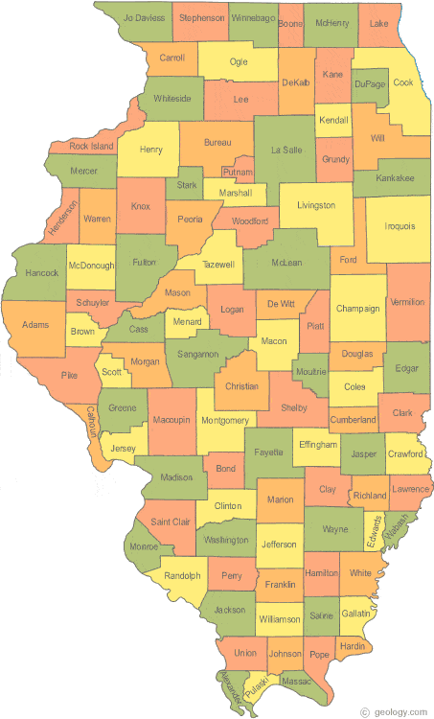
The Fourteenth Amendment
…No state shall make or enforce any law which shall abridge the privileges or immunities of citizens of the United States…
Nor shall local government infringe on free speech

Slide 4
Old School Free Speech
Letter to Editor
Speech at Public Meeting
Protest in the Park

Slide 5
Social Media
The New Frontier

Slide 6
The New Soap Box
SOCIAL MEDIA
Forms of electronic communication (such as websites for social networking and microblogging) through which users create online communities to share information, ideas, personal messages, and other content (such as videos). First known use—2004!
“Social media.” Merriam-Webster.com Dictionary, Merriam-Webster, https://www.merriam-webster.com/dictionary/social%20media. Accessed 19 Sep. 2022.

Slide 7
Interactive Networking Sites
Facebook
Instagram
YouTube
Twitter
LinkedIn

Slide 8
What’s So Different about Social Media?
People feel less inhibited about sharing their thoughts
Speech can be shared with the world
Speech can be impactful
For the good
Or the bad
New issue for the courts

Slide 9
Government Use is Now the Norm
Interactive Communication at Every Level of Government
@JoeBiden
37.6 M followers
@LeaderMcConnell
2.1 M followers
@GovPritzker
251 K followers
@D28Northbrook
455 followers

Slide 10
Tell Us What You Really Think…
@AOC
“It’s appalling that far-right politicians seem to have decided that fall before an election is their regularly scheduled time to commit crimes against humanity on refugees. Don’t normalize this. Lying to & trafficking people for TV and clicks isn’t politics as usual. It’s abuse.” 9/16/22
“It’s a crime when a Republican transports 50…but when democrats bring in millions it’s not…is this your position? @donnieplmr, 9/16/22. 1,157 likes
@D28Northbrook
“District 28 has developed an inclement weather plan that allows for the use of snow days and/or e-learning days if in-person instruction is not possible.
1 like
85.1K likes

Slide 11
Courts Tackle Issue of First Amendment Rights on Social Media

Slide 12
Fundamental Right
Social Media is the “modern public square.” Supreme Court held that law prohibiting sex offenders from using social media violated First Amendment. Packingham v. North Carolina, 137 S. Ct. 1730 (2017).
All persons should have access to places where they can speak and listen
Cyberspace is now that place

Slide 13
Public Forums in the Physical World
Traditional Public Forum
Parks
Public Square
Designated Public Forum
Government property that is not traditionally used as a public forum is intentionally opened up for that purpose
Meeting room
Assembly hall
Limited Public Forum
Space that is limited to use by certain groups or dedicated to the discussion of certain topics
Limiting use of public school meeting room to groups associated with school.

Slide 14
Rights are Dependent on Type of Forum
Traditional Forum
Designated Forum
Limited
Forum

Slide 15
The First Amendment in the Digital World
Trump creates @realDonaldTrump in 2009
Continues to use account after becoming POTUS
Trump blocked certain Twitter users from his account in 2017 after he became president
YOU’RE BLOCKED!
Users file First Amendment lawsuit. Knight First Amendment Inst. at Columbia Univ. v. Trump, 928 F.3d 226 (2d Cir. 2019)
Court must decide if the First Amendment applies

Slide 16
Is @realDonaldTrump a Public Forum?
Twitter account used to communicate with public about his administration
“I have made my decision on who I will nominate for The United States Supreme Court. It will be announced live on Tuesday at 8:00 P.M.” 1/30/17
“I will be announcing my decision on Paris Accord, Thursday at 3:00 P.M. The White House Rose Garden. MAKE AMERICA GREAT AGAIN!” 5/13/17
Photos show President engaged in official duties
“Official statements” of President
It’s public, not private

Slide 17
Is it a Public Forum?
Court looks at interactive element
It’s not just Trump’s speech
Public can respond, retweet, comment, like
This is different than a traditional website
The interactive element makes it a public forum for free speech

Slide 18
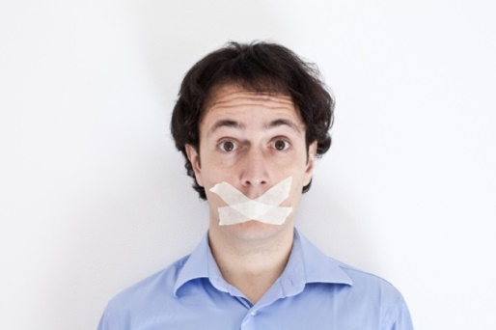
Cannot Censor Based on Viewpoint
First Amendment prohibits viewpoint discrimination in a public forum (regardless of whether it is traditional, designated or limited)
Cannot block users because disagree with views
Court says you don’t have to listen to what they say, but you have to allow them the right to speak

Slide 19
Lawsuits against Local Officials
Davison v. Randall, 912 F.3d 666 (4th Cir. 2019)
Virginia county board chair had a Facebook page
“Chair Phyllis J. Randall”
“I really want to hear from ANY Loudon citizen on ANY issues, request, criticism, complement or just your thoughts.”
Used page to notify public of meetings, subjects of public discussion, public safety issues

Slide 20
Be careful what you wish for…
Randall posts about town hall meeting
Outspoken resident, Brian Davison, replies with post about conflicts of interest and kickbacks
Randall deletes her original post and all comments
Bans (then reinstates) Davison
Davison sues her

Slide 21
Open Forum
She intentionally opened forum to public comment (ANY issues, requests, criticisms)
She placed NO restrictions on public access
“Exchange of views” is precisely what she sought
She banned Davison based on viewpoint
Even though she later reinstated him, the threat that she would do it again existed, so he was allowed to sue

Slide 22
First Amendment Violation
Randall created a public forum
Engaged in viewpoint discrimination
Violated Davison’s First Amendment Rights

Slide 23
Some Courts Take a Different Approach
Lindke v. Freed, 37 F.4th 1199
City Manager has FB page--created before holding public office
Posts about private life as well as public events (COVID policies)
Deletes citizen’s post critical of COVID policy and blocks him from page

Slide 24
Did Official Engage in “State Action”
Is maintaining FB page part of his actual or apparent duties? NO
FB page is not derived from his duties as City Manager and does not depend on his state authority to operate it
He did not use gov’t staff or funds to run FB page
No ordinance required him to operate the page
He started the page before he held office
FB page did not belong to “Office of City Manager”
No official City account directed users to FB page

Slide 25
No State Action = No First Amendment Violation
Court holds that “Freed’s Facebook activity was not state action.”
“The page neither derives from the duties of his office nor depends on his state authority.”
Freed operated page in personal (not official) capacity

Slide 26
Twitter Takeaways…
What do you call your account?
Do you reference your office?
i.e. “Chair Phyllis Randall”
Do you use an official email address/contact information?
Do you link your page to official website or other official accounts?
If so, this weighs in favor of creation of public forum

Slide 27
Who Maintains the Account?
Do public employee’s help manage account?
While on duty?
Do public employees assist in creating posts?
If so, then public funds are being used in the management of the account, and more likely it’s a public forum

Slide 28
What Do You Post About?
Public meetings
Issues of public interest
Photos of you engaged in public business
Policy decisions
Then more likely a public forum

Slide 29
How “Open” is the Forum
Is your page public?
Is it a “private” account open only to “friends?”
The more public, the more likely it is a public forum

Slide 30
Interactive Element
Do you encourage public interaction?
“I want to hear from you on issues that matter to you..”
“Let me know what you think”
Public can “like,” or communicate via emoji or comments

Slide 31
Public vs. Private
Clearly delineate public vs. private account
Private account
Private email address
No link to official websites or accounts
Family pics, vacation pics
No discussion of public business
No help from public employees
Public account
Public email address
Link to public body website
Posts about public business
Staff can assist with account
No viewpoint discrimination

Slide 32
A Little Bit of Both?
If it’s too late, and you’ve already mixed public and personal business
Don’t ban users based on viewpoint
Don’t delete or hide comments based on viewpoint
You can close entire account and start over with one for public business and one for private business
But you probably need to retain copies of public records from public account

Slide 33
Creating a “Limited” Public Forum
What Rules are allowed?

Slide 34
What Restrictions are Legal for Public Account?
Reasonable time, place, and manner restrictions can be imposed in any public forum IF
(1) content-neutral, (2) narrowly tailored to serve a significant government interest, and (3) leave open ample alternative channels for communication of the information.
Real world permissible restrictions
Time limit to speak
No threats of violence
Limit speech to topic of meeting
Don’t censor based on viewpoint

Slide 35
How to Lawfully Police an Interactive Account
If you want to allow comment, create a limited public forum
Draft a social media policy and make it VERY public
Include social media policy on all platforms
Follow your own policy
Monitor for violations
Enforce consistently

Slide 36
How to Create a Limited Public Forum
Enact and publish rules relating to the use of social media platforms
Public may comment only on topic of post
Threats of violence not permitted
Obscenity not permitted
Should not be used to request emergency services
Prohibit discrimination on basis of any protected class
Prohibit content published without proper license
Prohibit posting personal information without consent
Prohibit hyperlinks that are unrelated to topic
Prohibit solicitations
Prohibit illegal activity

Slide 37
Notice and Disclaimers
Posts that violate policy will be deleted
Users who repeatedly violate terms of use may be banned from site (last resort)
Reserve the right to modify policy
State that comments are the opinion of the commentator and publication does not imply endorsement by public body

Slide 38
Publish Rules
Make sure public has easy access to the rules
Post prominently on your website
Post on any public platform that permits you to publish terms of use
Facebook business page impressum
Make sure the rules are easy to find and reasonable

Slide 39
Evenhanded Enforcement
Monitor posts—assign someone competent
No selective enforcement
All rule violations should be addressed fairly
You may lose “limited” public forum status if you fail to monitor for violations

Slide 40
Dealing with Rule Violations
Provide due process
Notice to user that comment will be or was deleted or that they will be banned
Keep a copy (screenshot) of post
Written explanation of why post violates rules
Give user chance to explain why post does not violate rules or why they should not be banned
Make final decision and inform user of decision

Slide 41
Careful Delegation of Authority
Decide who will administer social media
Require employees to have appropriate authority before posting on behalf of public body
Assign an appropriate employee to monitor site on a daily basis—not the summer clerk!
Assign appropriate employee to administer due process protections
Mistakes can be costly!

Slide 42
Want to Avoid the Issue entirely?
Don’t use social media
Create a website—not an interactive account
Government Speech only

Slide 43
Preservation and Disclosure Requirements
Social Media posts can be public records!

Slide 44
Local Records Act
Local Records Act definition of public record includes:
Electronic material made or received by public agency or officer in connection with public business
Tweets, FB posts, Photos posted online, comments should be preserved

Slide 45
Local Records Act
Local Records Comm’n recommends only posting copies of public records on social media, so that the requirement for preservation is not triggered
Also recommends setting up accounts for viewing only, with no comment
Recommends having only one agency account
https://www.cyberdriveillinois.com/publications/pdf_publications/ard167.pdf
Discuss with Local Records Commission what you should be preserving and ensure that you have a schedule for preservation in place

Slide 46
Freedom of Information Act
Posts on social media are public records under FOIA if they meet this definition:
electronic communications…pertaining to the transaction of public business, regardless of physical form or characteristics, having been prepared by or for, or having been or being used by, received by, in the possession of, or under the control of any public body.

Slide 47
Open Meetings Act
Avoid holding an illegal meeting in violation of OMA on social media
Meeting is defined as:
Any gathering, of a MAJORITY OF A QUORUM to discuss PUBLIC BUSINESS
“Electronic” meeting (i.e. social media communications) can meet this definition

Slide 48
Employee Use of Social Media
Balancing Employer vs. Employee rights

Slide 49
Two Social Media Policies
One policy should regulate a citizen’s right to speak on public body’s social media accounts
A second policy should regulate employee’s right to speak on social media
When they act on behalf of the public body
When they act in a personal capacity

Slide 50
Employees Have First Amendment Rights
Employees don’t shed constitutional rights at work
They have the right to speak on matters of public concern
But employers can discipline when speech causes disruption to efficient operations

Slide 51
Social Media Policy for Employees
You can and should have a social media policy for employees
Provide notice that they cannot post on behalf of public entity without authorization
Provide notice that they may not disclose confidential information
Expected to comply with non-discrimination policy and other employer policies
Provide notice that they may be disciplined for violating employer policies, even when using social media outside of work

Slide 52
Employee vs. Employer Rights
Employees have the right under the First Amendment to speak as a citizen on matters of public concern—this applies to social media
But even when employees exercise this right, employers may still impose discipline in some cases
Courts weigh employee’s right to free speech against the employer’s interests in an efficient, disruptive-free workplace

Slide 53
What is Speech as a Citizen?
Internal disciplinary matter? Probably not.
Complaint about supervisor? Maybe.
Presidential candidate? Probably yes.

Slide 54
Complaint about Discipline
Employee repeatedly violates policy on tardiness
Receives written warning
Rants about it on FB
Probably not speech AS A CITIZEN
Probably not speech ON A MATTER OF PUBLIC CONCERN

Slide 55
Disruption Factor
The greater the disruption to efficient operations, the more likely the employer can discipline without violating employee’s First Amendment rights.

Slide 56
Example: Racist Comments
Sheriff’s department has a policy against discrimination on the basis of any protected class, including race
Deputy posts on his private FB profile about upcoming election and denounces suspected unethical conduct by a candidate using racial slurs
Deputy’s FB friend takes screenshots, and gives a copy to Sheriff
Can Sheriff impose discipline?

Slide 57
Let’s Figure Out the Answer…
Did employee exercise his First Amendment Rights?
Yes. He spoke as a citizen on a matter of public concern.
He has a right as a voter to comment on a candidate for office
Does employee’s speech impair the efficient provision of services by the Sheriff?
Yes. The deputy’s use of racial slurs would likely diminish the public’s trust in the Sheriff’s ability to serve the public equally without regard to race
Sheriff can impose discipline

Slide 58
Balancing Test
If employee speaks as a citizen on a matter of public concern
Then employer must look at the disruption to efficient operations caused by that speech
Case-by-case analysis

Slide 59
Final Example
County Board member running for re-election
County employee posts on social media that he is supporting opposing candidate
Corruption and political favoritism
Should employee be disciplined?
Is it speech on a matter of public concern? YES
Does it cause disruption to internal operations? MAYBE/MAYBE NOT

Slide 60
Closing Points
Review your social media accounts
Consider website vs. social media
If you allow comments, create a LIMITED public forum
Consistently monitor for rule violations
Don’t block or delete based on viewpoint
Create social media policies for citizens and for employees
Considering blocking a user or disciplining an employee for social media use?
Speak to counsel

