Slide 1
Progressive Discipline and Managing Employee Behaviors
Presented by: Julie A. Bruch
OKGC Law, LLC
Northbrook, Springfield, O’Fallon
847-291-0200
jbruch@okgc.com
This Photo by Unknown Author is licensed under CC BY-SA-NC

Slide 2
Attitude Issues
Bad attitudes usually cannot be fixed.
Terminate as soon as possible – 30 days to be an eligible employer under unemployment.
820 ILCS 405/1502.1(A)(3).

Slide 3
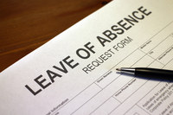
Employee Leaves
Have up-to-date handbook.
Is this worker’s compensation?
Notify responsible person (supervisor, manager, etc.).
Employees cannot use personal time, sick time, vacation, etc. instead of going on FMLA. They happen at the same time.
FMLA (off 3 days or more).
ADA?
Have employee fill out all forms.
Remind employee (with a cover letter, email etc.) that their FMLA is running out). Contact Julie Bruch for help.

Slide 4
Supervisor Notes
Every supervisor should keep notes of employees underneath you.
Does not have to be formal. Whatever method works best for you – handwritten, Word docs, pre-printed forms, calendar notes, etc.
Try to keep track of positives and negatives.
The more detailed the better.
If witnesses to an incident, include in note.

Slide 5
Performance Reviews
Do the performance reviews accurately capture information you want to share with employee?
Do you want employees to self-evaluate? Good way to find out if there is a disconnect between you and employee.
Be honest in your evaluation.
Include positive feedback.
Give specific examples to support evaluation.
Use your notes from the year to prepare the review.

Slide 6
Regular Communication Among Management
Aim for consistency among management.
Reward positive behavior/performance.
Discuss strategies for helping struggling employees.
Job restructuring?
Supervisors must supervise – don’t let problems linger and grow before taking action.

Slide 7
Documenting Tips
Treat everyone the same
Document improvements to job to help employee
If part of job description, they must do all duties listed, if not create a new job description
Keep documents as factual as you can, avoid personal comments. Keep emotion out.
Keep track of employee conversation, keep notes

Slide 8
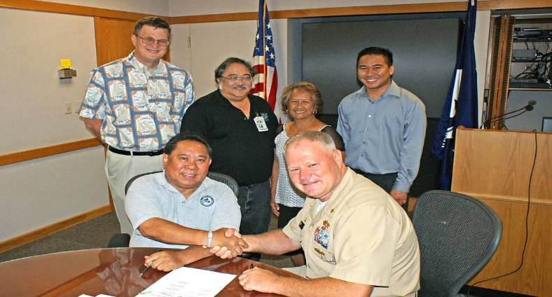
Collective Bargaining Agreement (“CBA”)
Where CBA requires disciplinary documents to be thrown out after a certain amount of time, still keep them (in a separate file). Needed if a lawsuit is filed.

Slide 9
Complaint from Citizens or Co-Workers
Ideally, complaint in writing, but should
not mandate.
Document the complaint you received yourself and then send a copy to the person who complained and see if it is accurate.
Send the person a letter that you will be investigating and they will not be retaliated against.
Respond to complaint by investigating or forward to person in charge of investigating the complaint.
Interview all witnesses, conduct neutral investigation.
Get witness statements.
Let all interested parties know the outcome of the investigation

Slide 10
Progressive Discipline
Progressive discipline policy, very few employers follow progressive discipline policy
Plaintiff’s attorney will use this against you if you have a progressive discipline policy and don’t follow it.
If you are not going to use that remove it from employee handbook/policy for non-union employees. This is not a law
If union, you can negotiate this in the collective bargaining agreement

Slide 11
Should You Discipline?
Be consistent. All employees should follow the rules, do not ignore problem
How have you dealt with violations/rules in the past, be consistent with everyone
Make sure the punishment fits the crime
Supervisor rule breaking can be dealt with harsher than regular employees
Are there personal issues the employee is going through? Consider offering FMLA/ADA, if appropriate.
Have they been warned or disciplined about the problem, previously?
Be careful about writing up employee after they complained about you if you were not documenting problems before.
Be aware of workplace morale, address the problems right away.
Consider a performance improvement plan to help employee with specific measures to meet and a timeframe to achieve goals.

Slide 12
Disciplinary Meetings
Have a witness present
Meeting should be close in time to the offense
Focus on rule violations
Describe facts supporting rule violation, not just “insubordinate”
Let employee respond
Give employee a copy of their discipline action and have them sign
If employee refuses to sign, scan and email them a copy and put in their personnel file

Slide 13
Termination
Have you properly documented all discipline?
Have a witness present when terminating.
Never terminate an employee in your office, use a conference room, etc.
Keep meeting professional, be calm.
Remember Luke Combs! Explain reason for termination, even though Illinois is an “at will” state.
Union employee – follow contract.
Always give due process, let them speak their mind.
Use documents as evidence to show reason of termination.
Get keys, laptop, employer-owned property.

Slide 14
Post-Termination Issues
Following termination meeting, write a memo to the file about what was said by each side.
Immediately change passwords.
Pay out unpaid vacation.
Employee will typically ask for unemployment (you may want to challenge this).
10-day deadline from receipt of claim to challenge unemployment.
Reference inquiries – do not step into the minefield!
Ideally have one person at your organization responsible for reference inquiries.
Do not speak “off-the-record” or trust others.

